Slide 1

Project Review on A Secure Multi-Floor Hotel Network Using VLAN-Based Wired and Wireless Architecture
Submitted by
G. Vineet 2420030375
Under the Esteemed guidance of
Sir Shaik Asif
Department of Computer Science and Engineering
Koneru Lakshmaiah Education Foundation (Deemed to be University estd. u/s. 3 of the UGC Act, 1956) Off-Campus: Bachupally-Gandimaisamma Road, Bowrampet, Hyderabad, Telangana - 500 043. Phone No: 7815926816, www.klh.edu.in

Slide 2
Outline of the presentation
Abstract
Introduction
Problem Statement
Project diagram
Objectives with justification
Methodology
Conclusion

Slide 3
Abstract
Design of a secure and scalable multi-floor hotel network using VLANs.
Supports guests, staff, and administrators with high performance and security.
Overcomes issues of traditional networks like congestion and security risks.
Uses VLANs for logical segmentation based on floors and access.
Integrates wired and wireless networks for seamless connectivity.
Improves efficiency, security, and traffic management.
Provides scalability, control, and reliable communication.

Slide 4
Introduction
Modern hotels require fast, secure, and reliable networks for guests and staff.
Traditional flat networks cause congestion, poor performance, and security issues.
This project uses VLAN-based architecture to segment the network efficiently.
Integrates both wired and wireless connectivity across multiple floors.
Ensures better performance, security, and scalability for real-world hotel environments.

Slide 5
Problem Statement
Existing hotel networks often use a single shared network for all users, causing security vulnerabilities, high broadcast traffic, and poor performance. Guest access may interfere with internal hotel systems, leading to data leakage and unauthorized access. A secure, well-structured network architecture is required to efficiently manage traffic across multiple floors and user groups.

Slide 6
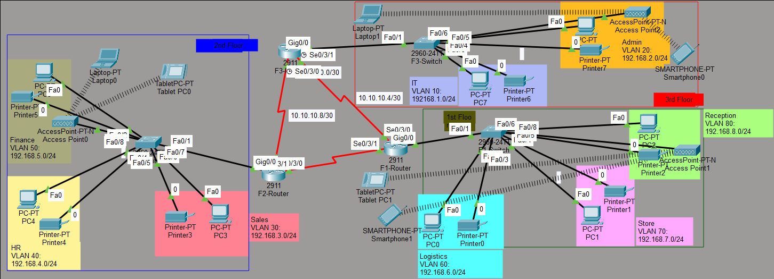
Capstone Project diagram

Slide 7
Objectives with justification
To design a secure multi-floor hotel network using VLANs
To isolate guest, staff, and administrative traffic
To improve network performance and security using wired and wireless integration

Slide 8
Methodology
The network is designed using a hierarchical architecture consisting of routers, managed switches, and wireless access points. VLANs are configured on switches to segment users floor-wise and role-wise. Inter-VLAN communication is controlled through routing and access control mechanisms. Wireless access points are mapped to VLANs to ensure secure wireless connectivity.

Slide 9
Conclusion
The VLAN-based hotel network provides enhanced security, reduced broadcast traffic, and improved scalability. It ensures efficient network management and reliable communication across multiple floors, making it suitable for modern hotel environments.

Slide 10
Thank you

